Slide 1


Slide 2

MAULANA AZAD NATIONAL INSTITUTE OF TECHNOLOGY, BHOPAL
MINOR PROJECT CA 308
MCA 2ND YEAR (3rd SEMESTER)
PRESENTERD BY :
UNDER THE GUIDANCE OF :
ANKIT PATIDAR (222120110)
AVISHKANT PATIDAR (222120038)
MOHIT SEN (222120111)
DR. SUJOY DAS

Slide 3




S O C I A L F L E E T
A Social Media Platform

Slide 4
INTRODUCTION
SocialFleet is an online platforms that allow users to connect with each other, share information, and create content.
SocialFleet be used for a variety of purposes, such as staying in touch with friends and family members, learning new things, finding communities with shared interests.
Social media websites are a powerful tool that can be used to connect with people all over the world.
SocialFleet has the prime objective of allowing an inherently limited group of individuals to connect in a special way
It’s the simple act of expanding the number of people you know by meeting your friends, their friends of friends and so on.
SocialFleet usually allow a new user to provide a list of people with whom they share a connection.
Then allow the people on the list to confirm or deny the connection.
New user can search the networks of connections to make more connections.
They may even suggest further connections based on a person’s established network.

Slide 5
FEATURES
Personal Profiles
Create your unique profile to showcase your interests, experiences, and connect with others.
Security
There is an admin who can delete unusual post and fake profiles.
News Feed
Stay up to date with the latest posts, news, and updates from your friends and favorite influencers.
Photo and Story Sharing
Share your visual moments and experiences through stunning photos and stories.

Slide 6
BENEFITS FOR USERS
Connect with Like-minded Individuals
Discover and connect with people who share your passions and interests in one seamless platform.
1
Stay Updated
Never miss an important update or exciting news from your friends and favourite content creators.
2
Showcase Your Creativity
Share your unique talents, creative projects, and moments of inspiration with a supportive community.
3

Slide 7

SCOPE OF THE PROJECT
Target Audience and Market
Our social media application caters to diverse demographics, including individuals, businesses, and creators.
Intended Reach and Impact
We aim to create a global community that inspires connection, collaboration, and positive change.

Slide 8



TECHNOLOGIES
REACT JS
NODE JS
MY SQL
We choose React.JS for the frontend of our project due to its component-based architecture, which allows for the creation of interactive and dynamic user interfaces with efficient rendering.
We opted for Node.js on the backend of our project because of its event-driven, non-blocking I/O model, facilitating scalable and high-performing server-side applications, along with its vast ecosystem of packages from npm.
We choose MySQL as the database for our project, leveraging its robust relational database management system to ensure data integrity, efficient querying, and scalability for storing and managing structured information effectively.

Slide 9

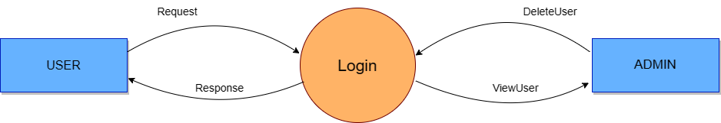
DFD
Level 0

Slide 10
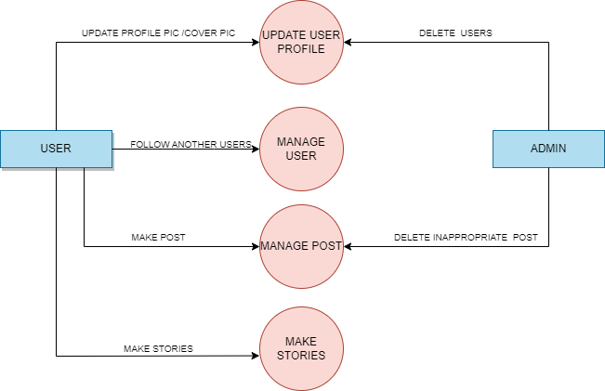
DFD
Level 1

Slide 11
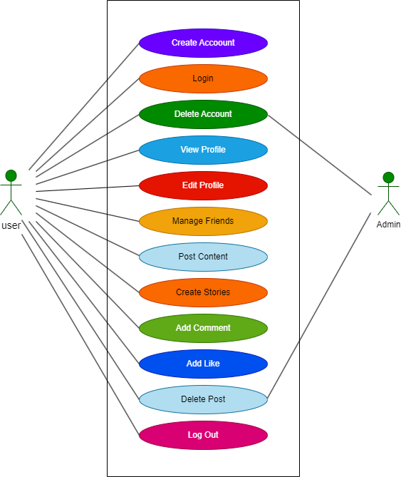
Use Case Diagram

Slide 12
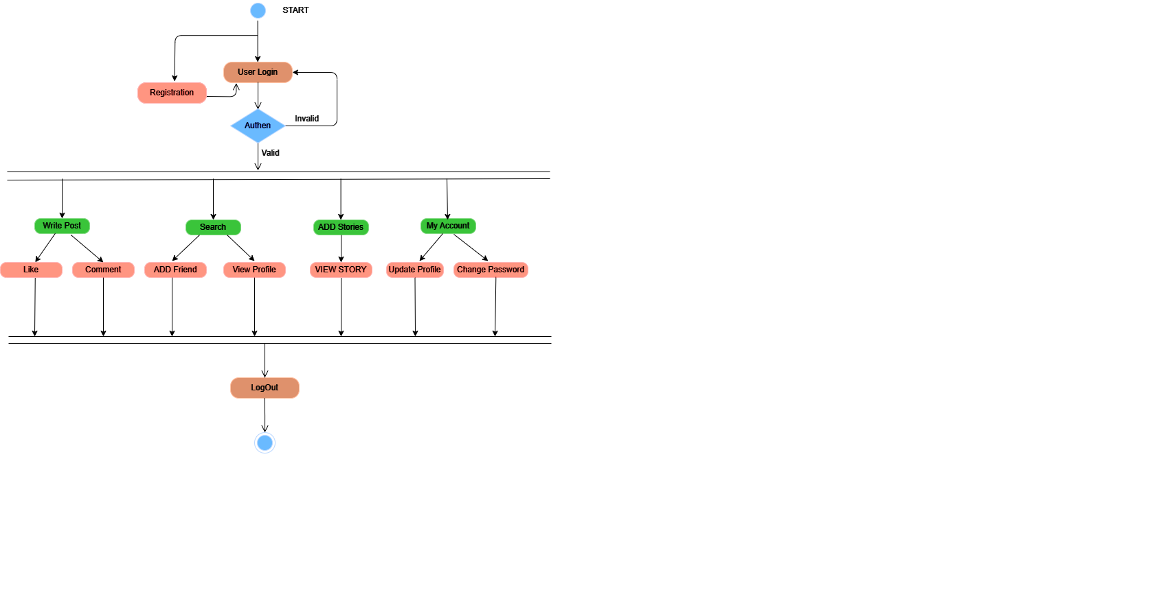
Activity
Diagram

Slide 13
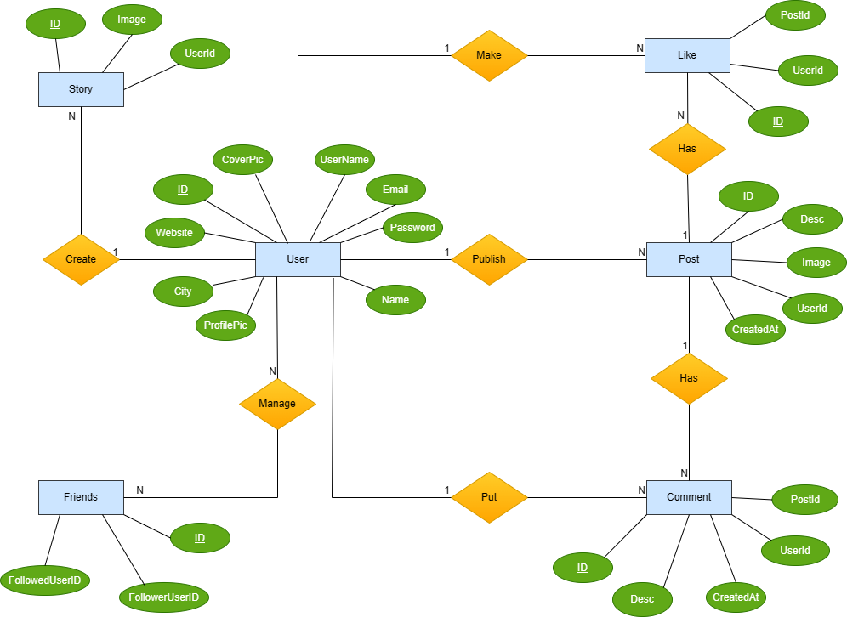
Old ER Diagram

Slide 14
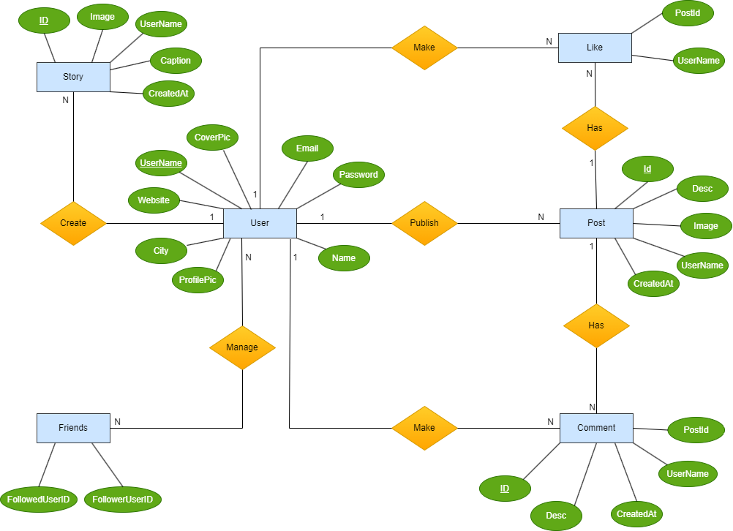
New
ER Diagram

Slide 15
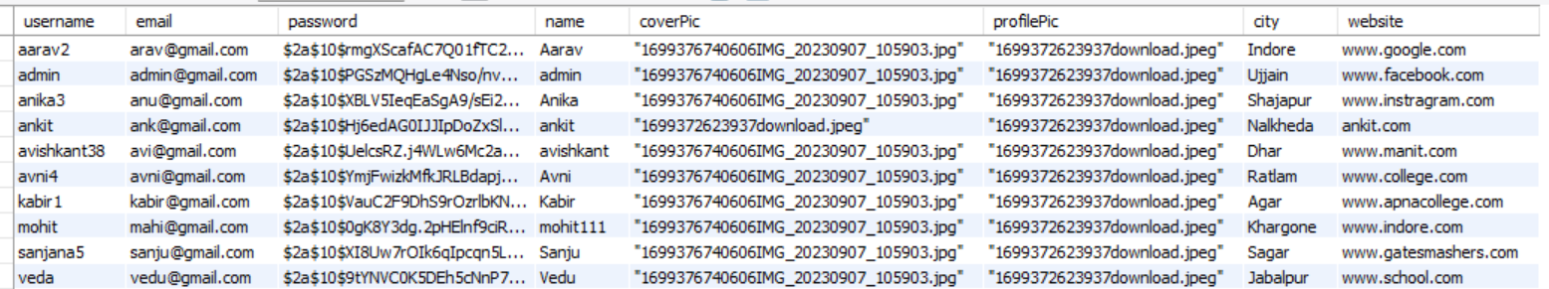
Database Tables with Dummy Data
User Table

Slide 16
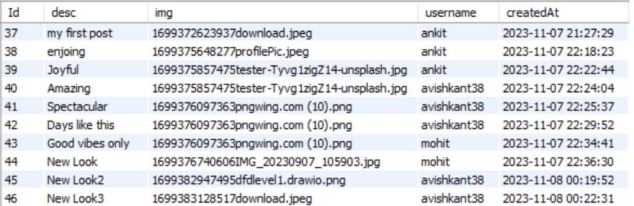
Post Table

Slide 17
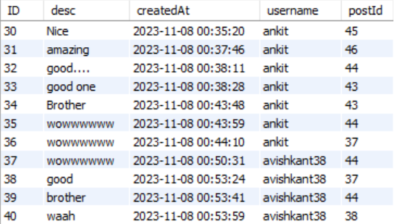
Comment Table

Slide 18
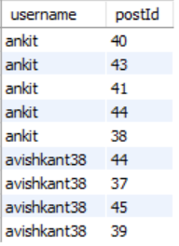
Like Table

Slide 19
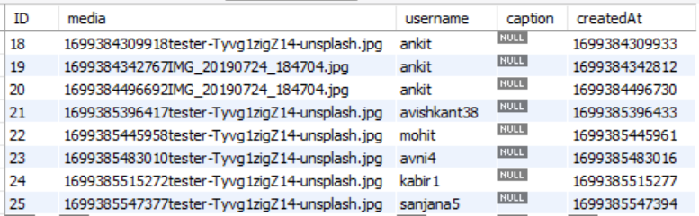
Story Table

Slide 20
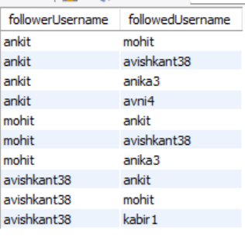
Relationship Table

Slide 21


Slide 22
Register Page

Slide 23
Register Page

Slide 24
Admin: Fetch Post By name API

Slide 25
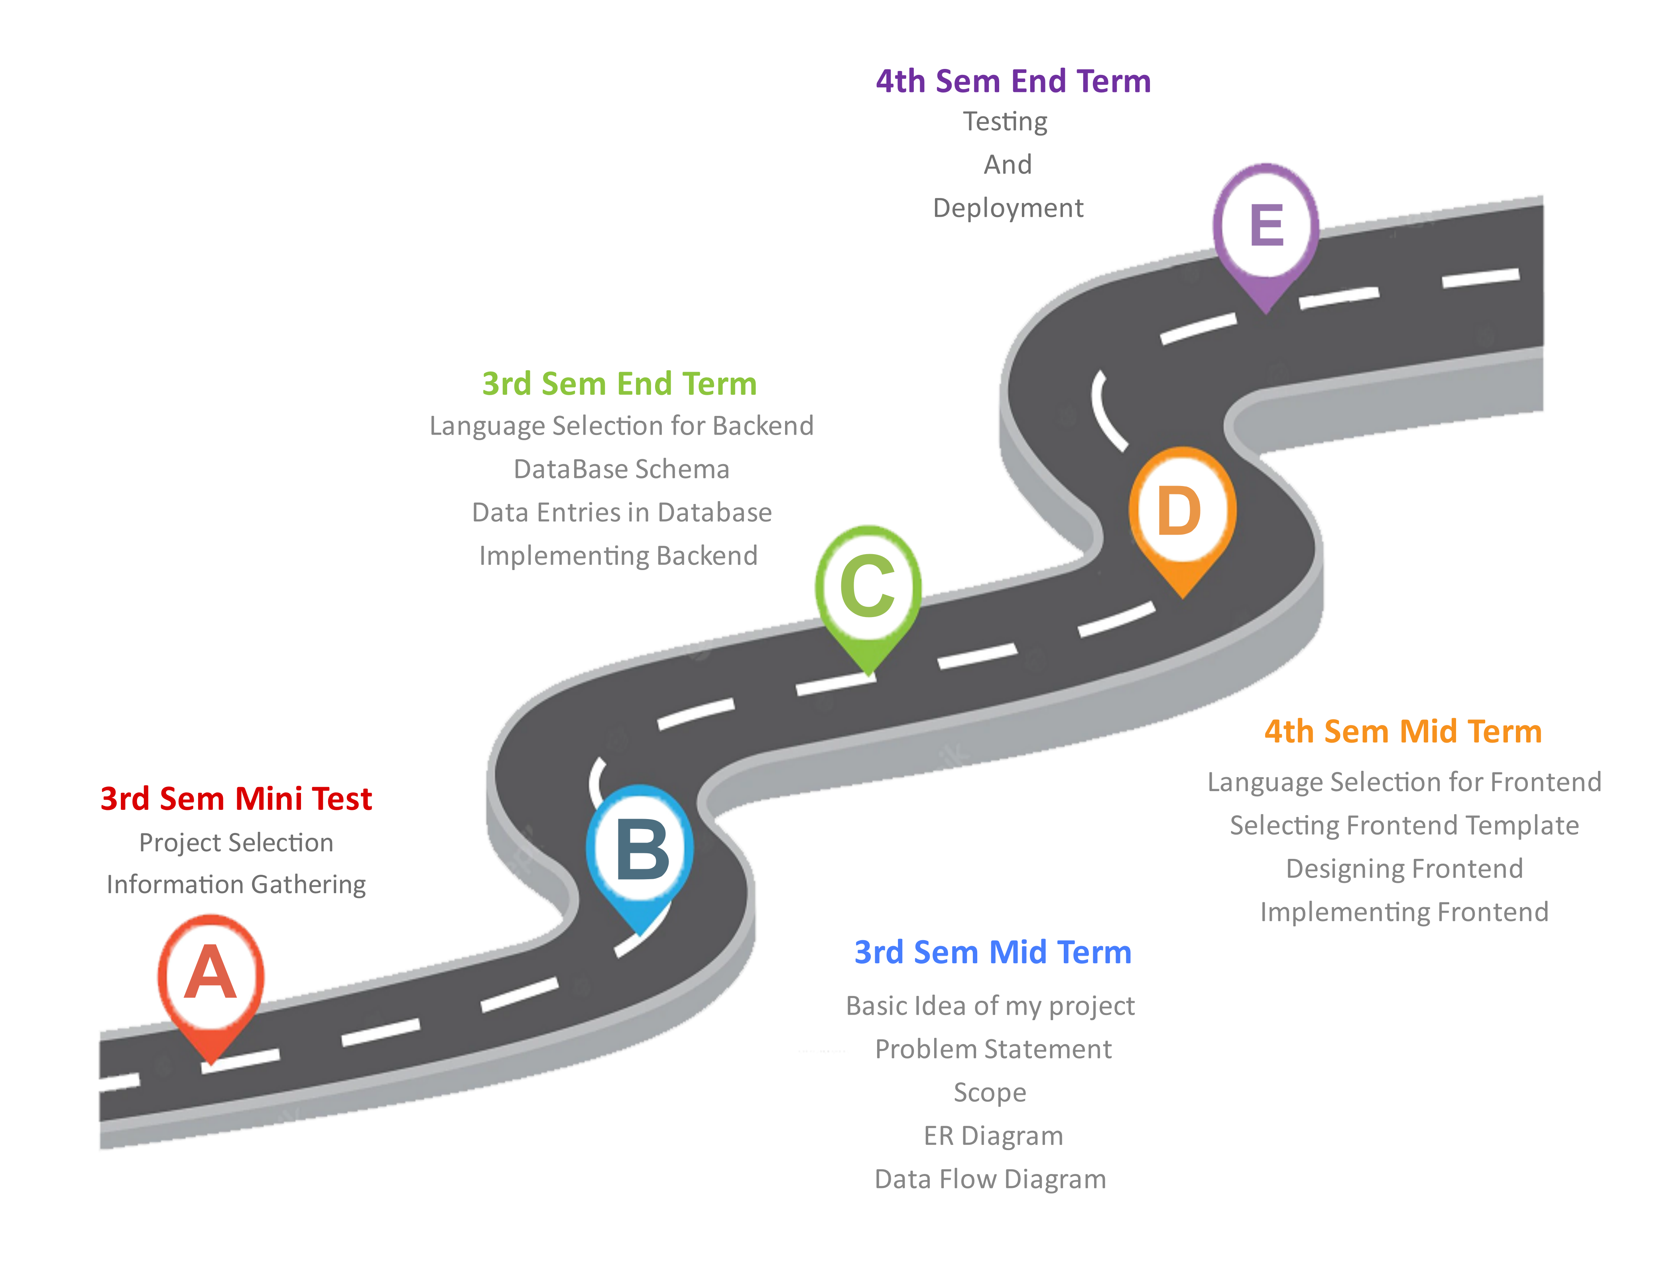

ROADMAP
FOR
Social Fleet
(A Social Media Platform)

Slide 26


